Slide 1

CS-401
Computer Architecture & Assembly Language Programming
Lecture-27
Real Time Interrupts and Hardware Interfacing

Slide 2

Lets revise the Last Lecture

Slide 3
Parallel Port

Slide 4
Loading Divider in Timer Channel
mov ax,0x1234
out 0x40,al
mov al,ah
out 0x40,al
mov al,0x30
out 0x43,al

Slide 5
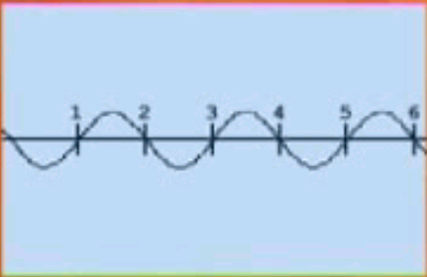
AC Intensity Control

Slide 6
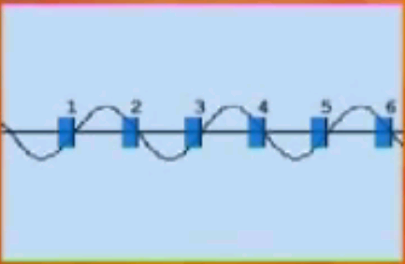
AC Intensity Control

Slide 7
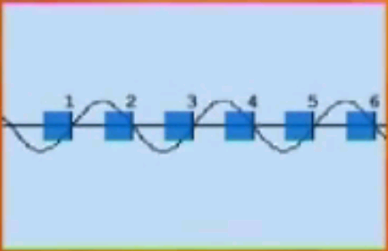
AC Intensity Control

Slide 8
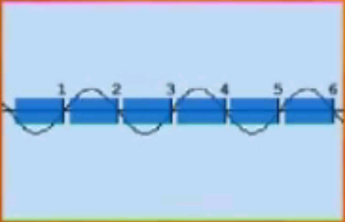
AC Intensity Control

